Slide 1
2020 Construction Logistics CSU Main Campus
Revision Update: 01/30/2020

Slide 2
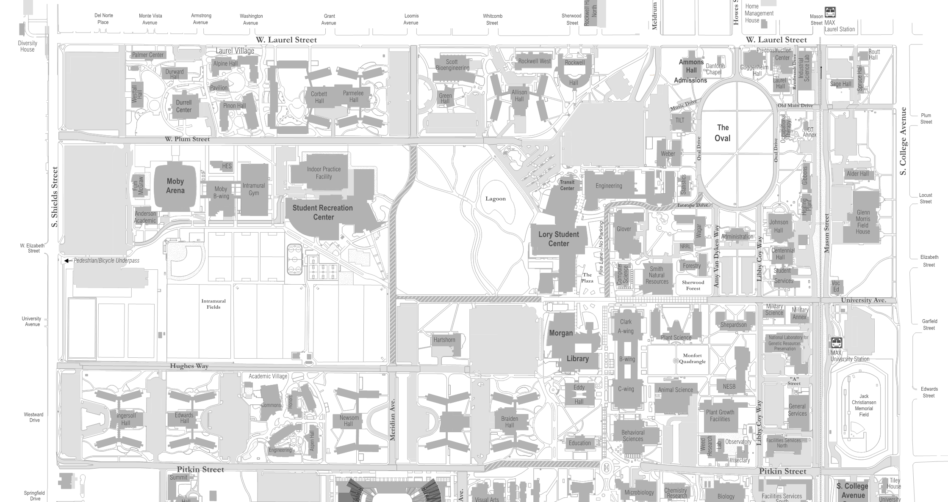
Construction Impacts – (Mid January – February 2020)
Lagoon
Nutrien Agricultural
Sciences Building
(Shepardson)
Libbie Coy Way Closed through Summer 2021
Hughes Way
South bike lane and Sidewalk Closed end of Feb.
Meridian
Village Ph 1
Note: construction dates are subject to change
Revision date: 02/10/2020

Slide 3
Construction Impacts – (March – Mid May 2020)
Lagoon
Amy Van Dyken/ Univ. Ave/ Lot 350 Closed
Nutrien Agricultural
Sciences Building
(Shepardson)
Libbie Coy Way Closed through Summer 2021
Hughes Way
South bike lane and Sidewalk Closed
Meridian
Village Ph 1
Note: construction dates are subject to change
Revision date: 01/30/2020

Slide 4
Construction Impacts – (Mid May – June 2020)
Street and
Parking Closed
Industrial
Science Lab
LSC Renovations through Summer 2021
LSC
Laydown
LSC
Lagoon
Amy Van Dyken/ Univ. Ave/ Lot 349 & 350 Closed
Geo X
Ph1
Meridian
Ave. Closed
Lot
412
Nutrien Agricultural
Sciences Building
(Shepardson)
Libbie Coy Way Closed through Summer 2021
Lot 425
Hughes Way
Street and parking closed
Temporary Access Road for Lot 425 Access
Meridian
Village
Ph 1
Sanitary Line
Replacement
Note: construction dates are subject to change
Revision date: 01/30/2020

Slide 5
Construction Impacts – (June – July 2020)
Street Paving
Street Paving
Street and
Parking Closed
Industrial
Science Lab
LSC Renovations through Summer 2021
Street Paving
LSC
Laydown
LSC
Lagoon
Amy Van Dyken/ Univ. Ave/ Lot 349 & 350 Closed
NCAA Women’s
Soccer & Softball
Complex
Geo X
Ph1
Meridian
Ave. Closed
Lot
412
Nutrien Agricultural
Sciences Building
(Shepardson)
Libbie Coy Way Closed through Summer 2021
Lot 425
Hughes Way
Street and parking closed
Temporary Access Road for Lot 425 Access
Meridian
Village
Ph 1
Street Paving
Sanitary Line
Replacement
Note: construction dates are subject to change
Revision date: 01/30/2020

Slide 6
Construction Impacts – (July – Mid August 2020)
Street Paving
Street Paving
Street and
Parking Closed
Industrial
Science Lab
LSC Renovations through Summer 2021
Street Paving
LSC
Laydown
LSC
Street Paving
Univ. Ave Closed
NCAA Women’s
Soccer & Softball
Complex
Geo X
Ph1
Meridian
Ave. Closed
Lot
412
Nutrien Agricultural
Sciences Building
(Shepardson)
Libbie Coy Way Closed through Summer 2021
Lot 425
Hughes Way
Street and parking closed
Temporary Access Road for Lot 425 Access
Elevator
Replacement
Meridian
Village
Ph 1
Street Paving
Sanitary Line
Replacement
Note: construction dates are subject to change
Revision date: 01/30/2020

Slide 7
Construction Impacts - Mid August - Oct 2020
LSC Renovations through Summer 2021
LSC
Laydown
LSC
NCAA Women’s
Soccer & Softball
Complex
Geo X
Ph1
Geo X
Ph2
Nutrien Agricultural
Sciences Building
(Shepardson)
Libbie Coy Way Closed through Summer 2021
Meridian
Village
Ph 1
Note: construction dates are subject to change
Revision date: 01/30/2020

Slide 8
Construction Impacts – (Oct. – Dec. 2020)
LSC Renovations through Summer 2021
LSC
Laydown
LSC
To be Completed Summer 2021
NCAA Women’s
Soccer & Softball
Complex
Geo X
Ph2
To be Completed Spring 2021
Nutrien Agricultural
Sciences Building
(Shepardson)
Libbie Coy Way Closed through Summer 2021
Meridian
Village
Ph 1
To be Completed Summer 2022
Note: construction dates are subject to change
Revision date: 01/30/2020

Slide 9
South Campus:
Additional Campus Construction Projects
Johnson Family Equine Hospital
Bay Facility
South Campus Utility Infrastructure
Foothills Campus:
CVID
Central Chill Plant
Temple Grandin Equine Center
Mountain Campus:
Wastewater Treatment Facility
Learning Center
* Along with Maintenance and Remodel Projects
Revision date: 01/30/2020

Slide 10
Communication and Outreach Plan:
Additional Presentations in 2020
Social Media
Source
Other News Media (Collegian, Coloradoan, etc.)
On-Site Project Posters
Display Information at Key Locations
Facilities Management Website
Tim Kemp, Asst. Director for Engineering and Capital Construction
Facilities Management
tim.kemp@colostate.edu
Office: 970.491.0051
Cell: 970.219.9762
Contact Information:
Revision date: 01/30/2020

